Slide 1
ATAI
Advanced Techniqueof Artificial Intelligence
ATAI
ChongqingUniversity _{AdvancedTechniqueof}
of Technology Artificial Intelligence
Chongqing University of
Technology
Chongqing University ^{ATAI}
_{of Technology} Advanced Techniqueof
Artificial Intelligence
Chongqing University of Technology
Chongqing University of Technology
Social Influence Learning for Recommendation Systems
code:no
—— CIKM 2024
Reported by ZhenDong Huang
1

Slide 2
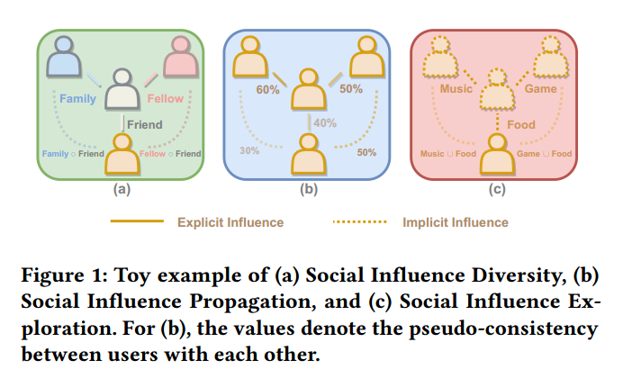
ATAI
AdvancedTechniqueof
Artificial Intelligence
ATAI
ChongqingUniversity _{AdvancedTechniqueof}
of Technology Artificial Intelligence
ChongqingUniversity of Technology
Motivation
1)Different types ofrelationships should have different patterns of influence passing.However, owing to the privacy issues, researchers face a lack oflabels on relationships
2)instead of theproximity on graph, the magnitude of social influence propagationshould depend on the consistency of behavior between the userand the neighborhoods, with higher consistency implying strongersocial influence, and vice versa.
3)However, simply connecting these users onthe social network is irrational and could cause user representation collapse.

Slide 3
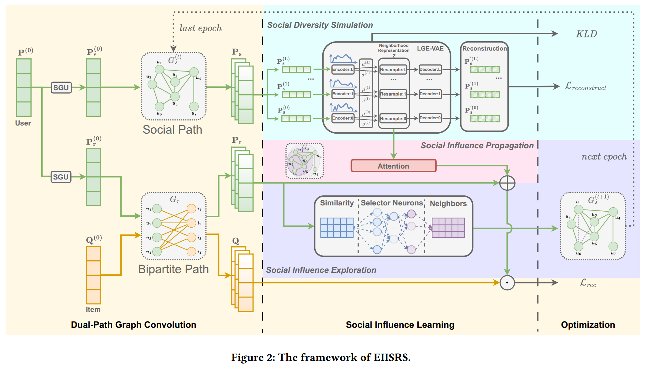
ChongqingUniversity of Technology
ATAI
AdvancedTechniqueof
Artificial Intelligence
ATAI
ChongqingUniversity _{AdvancedTechniqueof}
of Technology Artificial Intelligence
Overview

Slide 4
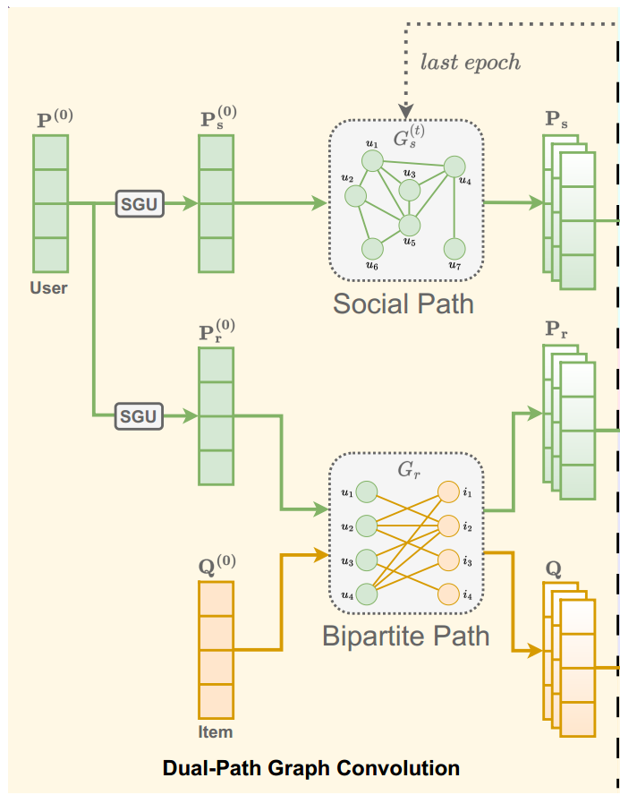
ChongqingUniversity of Technology
ATAI
AdvancedTechniqueof
Artificial Intelligence
ATAI
ChongqingUniversity _{AdvancedTechniqueof}
of Technology Artificial Intelligence
Method

Slide 5
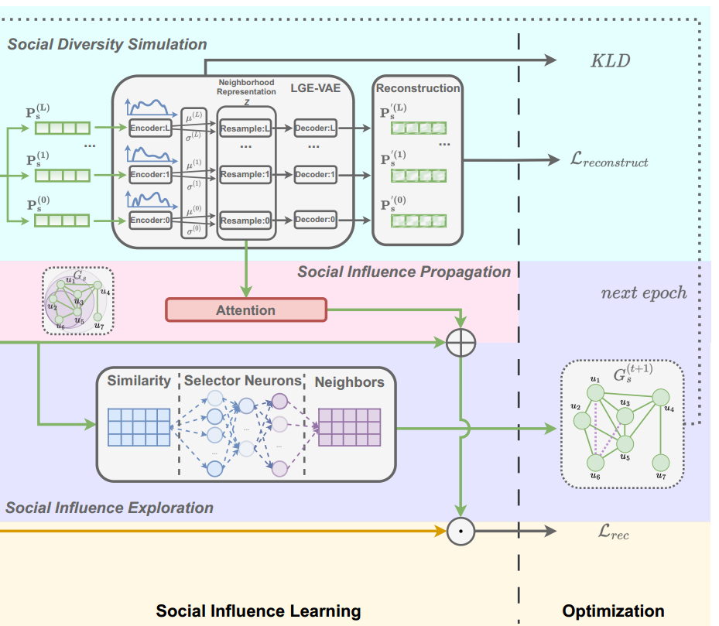
ChongqingUniversity of Technology
ATAI
AdvancedTechniqueof
Artificial Intelligence
ATAI
ChongqingUniversity _{AdvancedTechniqueof}
of Technology Artificial Intelligence
Method

Slide 6
ChongqingUniversity of Technology
ATAI
AdvancedTechniqueof
Artificial Intelligence
ATAI
ChongqingUniversity _{AdvancedTechniqueof}
of Technology Artificial Intelligence
Method

Slide 7
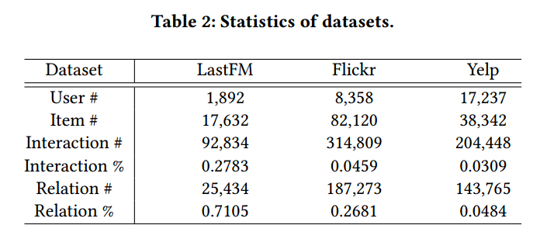
ATAI
AdvancedTechniqueof
Artificial Intelligence
ATAI
ChongqingUniversity _{AdvancedTechniqueof}
of Technology Artificial Intelligence
ChongqingUniversity of Technology
Experiments

Slide 8
ATAI
AdvancedTechniqueof
Artificial Intelligence
ATAI
ChongqingUniversity _{AdvancedTechniqueof}
of Technology Artificial Intelligence
ChongqingUniversity of Technology
Experiments

Slide 9
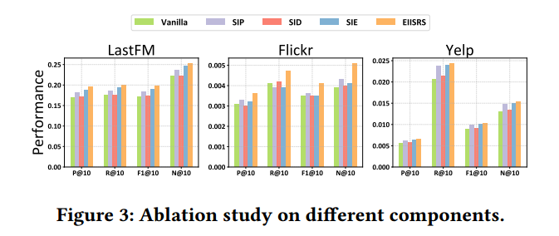
ATAI
AdvancedTechniqueof
Artificial Intelligence
ATAI
ChongqingUniversity _{AdvancedTechniqueof}
of Technology Artificial Intelligence
ChongqingUniversity of Technology
Experiments

Slide 10
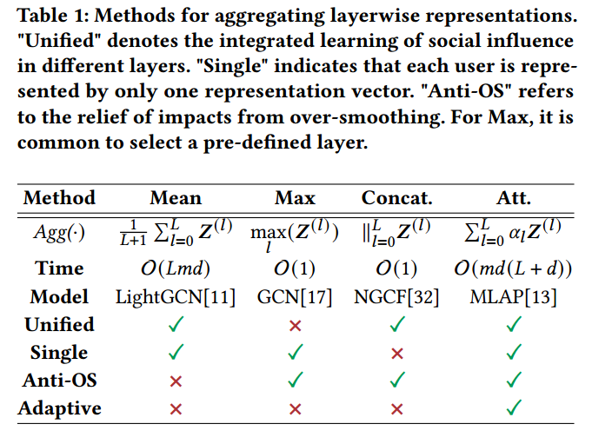
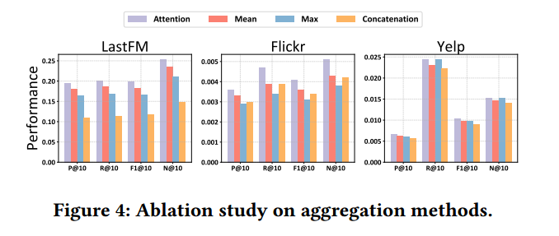
ATAI
AdvancedTechniqueof
Artificial Intelligence
ATAI
ChongqingUniversity _{AdvancedTechniqueof}
of Technology Artificial Intelligence
ChongqingUniversity of Technology
Experiments

Slide 11
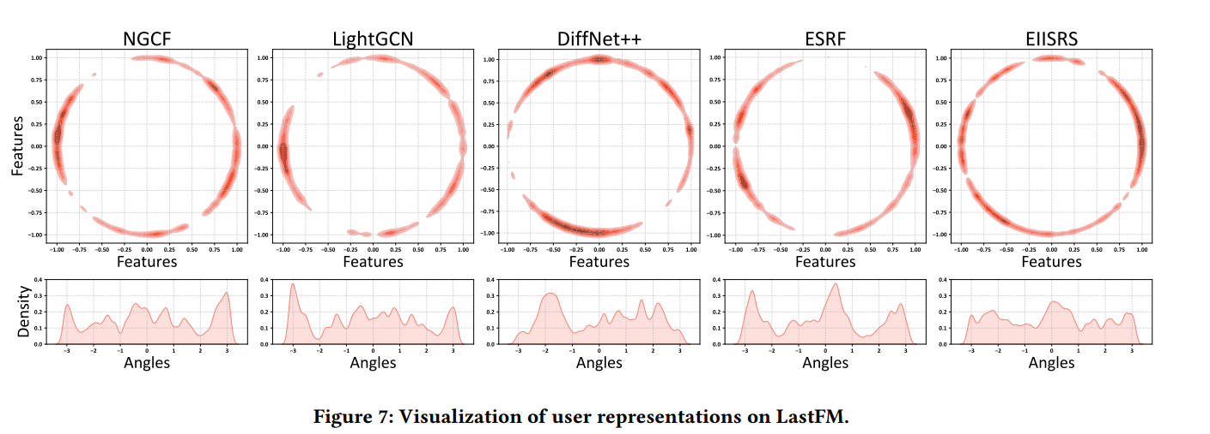
ATAI
AdvancedTechniqueof
Artificial Intelligence
ATAI
ChongqingUniversity _{AdvancedTechniqueof}
of Technology Artificial Intelligence
ChongqingUniversity of Technology
Experiments

Slide 12
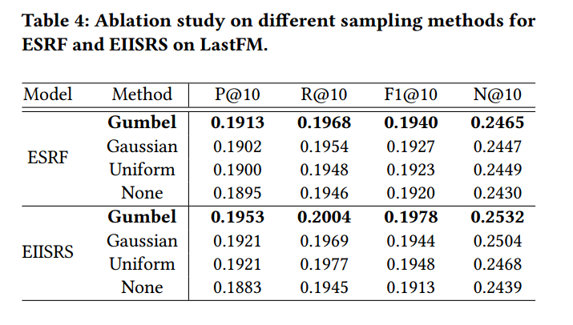
ATAI
AdvancedTechniqueof
Artificial Intelligence
ATAI
ChongqingUniversity _{AdvancedTechniqueof}
of Technology Artificial Intelligence
ChongqingUniversity of Technology
Experiments

Slide 13
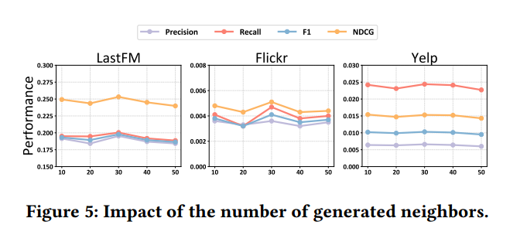
ATAI
AdvancedTechniqueof
Artificial Intelligence
ATAI
ChongqingUniversity _{AdvancedTechniqueof}
of Technology Artificial Intelligence
ChongqingUniversity of Technology
Experiments

Slide 14
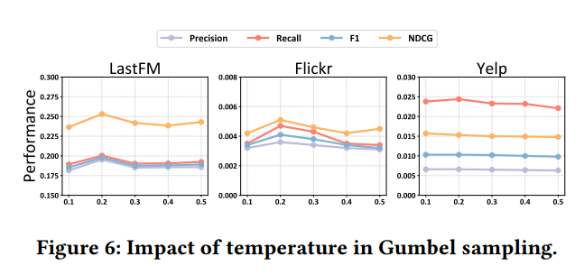
ATAI
AdvancedTechniqueof
Artificial Intelligence
ATAI
ChongqingUniversity _{AdvancedTechniqueof}
of Technology Artificial Intelligence
ChongqingUniversity of Technology
Experiments

Slide 15
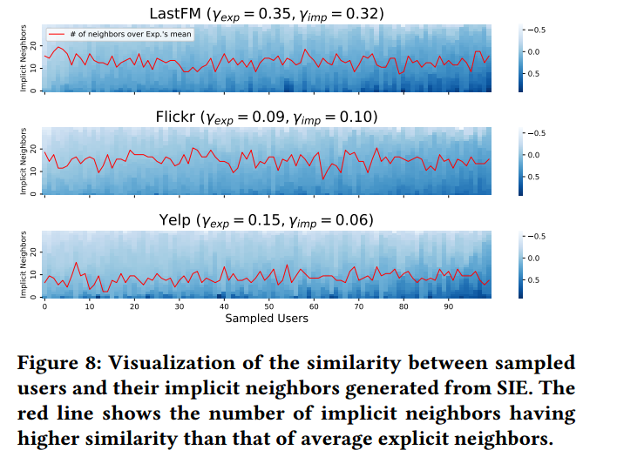
ATAI
AdvancedTechniqueof
Artificial Intelligence
ATAI
ChongqingUniversity _{AdvancedTechniqueof}
of Technology Artificial Intelligence
ChongqingUniversity of Technology
Experiments

Slide 16
ChongqingUniversity of Technology
ATAI
AdvancedTechniqueof
Artificial Intelligence
ATAI
ChongqingUniversity _{AdvancedTechniqueof}
of Technology Artificial Intelligence
Thanks!

